Slide 1
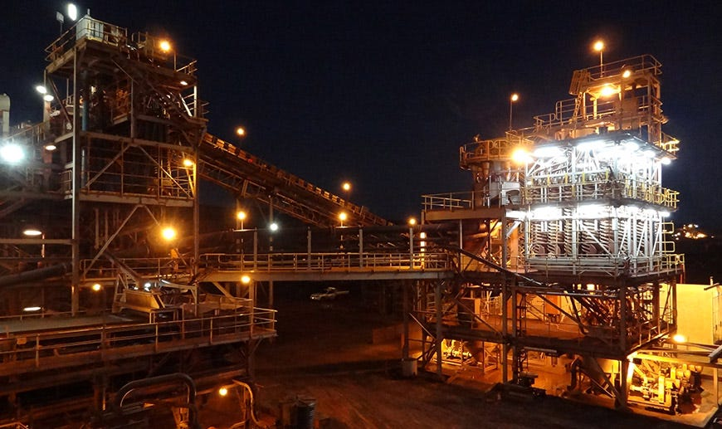
Quality prediction in mining process
Team Members :
Student Name Student ID
Student Name Student ID
Bharath Kumar Nakka 700744145
Mounika Prathapani 700745641
Srilaxmi Pavuluri 700745445

Slide 2
Roles/Responsibilities and Contribution to the Project:
NAME | RESPONSIBILITIES AND CONTRIBUTION
BHARATH KUMAR NAKKA | Preprocessing of data, data collection and preparation,Comparative analysis of results
MOUNIKA PRATHAPANI | Building regression models on PCA transformed data
SRILAXMI PAVULURI | Exploring the data,Building baseline models

Slide 3
Motivation:
The percentage of Silica in Iron ore decides so many factors in real life for example quality of the steel products. Silica is the most common impurity in iron ore extraction. The percentage of silica defines the purity of the iron. Knowing the accurate percentage of silica impurity helps to plan the manpower and operational costs. High amounts of silica forms the slag and defines the quality of steel products in steel making. The motivation of the project stems for the following advantages:
In traditional laboratories the analysis takes a considerable amount of time.In machine learning the prediction and analyzing time is very less.
In some situations it becomes a tedious task to analyze the lot of parameters to predict the percentage of Silica.
Machine learning quantifies the prediction results using a wide range of parameters.

Slide 4

Objectives:
Five main objectives of the project are:
Building multiple machine learning regression models to predict the % of Silica Feed in Iron ore.
Exploring the data variability.
To reduce the variability in the data PCA dimensionality reduction method is applied.
Consolidating the results of the models and conducting an experimental analysis
Projecting PCA transformed data on to 2 dimensional plane

Slide 5
Related work:
Research on quality prediction of iron ore green pellets based on optimised neural network:
Summary: Iron ore comes in the form of rocks and pellets. These pellets' colour depends on the iron oxide percentage dark green , yellow and grey. Green pellet quality prediction is used to plan the process to yield high quality ores. In this paper whale optimisation algorithm is used to optimise the GRU network. Results of this network are compared with the laboratory results and it concludes that the optimised GRU network out performed the traditional deep learning algorithms [3].

Slide 6
Related work:
Multi-Target Regression for Quality Prediction in a Mining Process:
Summary:Existing methods predicted the percentage of silica in the iron ore. In this study a novel approach is proposed to predict both the targets at the same time using Multi-target regression methods. For the experimental analysis RandomForest, AdaBoost and KNN regressors are used and performance is evaluated using the R^2 metric [1].
Prediction of Quality Indicators of Iron Ore Processing Operations Using Deep Neural Networks
Summary: Existing methods depend on the laboratory results which are produced every 2 hours. In real time with these discrete methods linear relationships can not be approximated. In this study a real time monitoring system is developed using a deep neural network architecture. Deep Neural Networks allow us to predict the continuous improvements and relationships [2].

Slide 7
Problem Statement
Iron ore extraction follows several steps finding the suitable iron deposit, mining operation, once the iron is mined by best methods next step is beneficiation.In this step impurities are removed from the ore. Silica is the most common impurity in iron ore extraction. Further steps are smelting and steel making processes. The percentage of silica defines the purity of the iron.In general, assessing and predicting iron quality requires analysing the complex relationship between variables, which demands domain expertise as well as chemical analysis, which is a time-consuming process.

Slide 8
Proposed solution
Machine learning models adaptable to changes in the model parameters and the scalability of the models are high; they can operate on large datasets as well. By leveraging the machine learning algorithms mining processing can be optimised in terms of manpower and operational costs.
In this paper we are proposing principal component regression models means combining the principal components with regression models
Datasets like mining contain highly correlated features because it is a combination of diverse factors like pulp quality and air flow. To mitigate the multicollinearity between the variables, dimensionality reduction method is used along with the regression models.
To asses the model robustness various evaluation metrics are used.

Slide 9
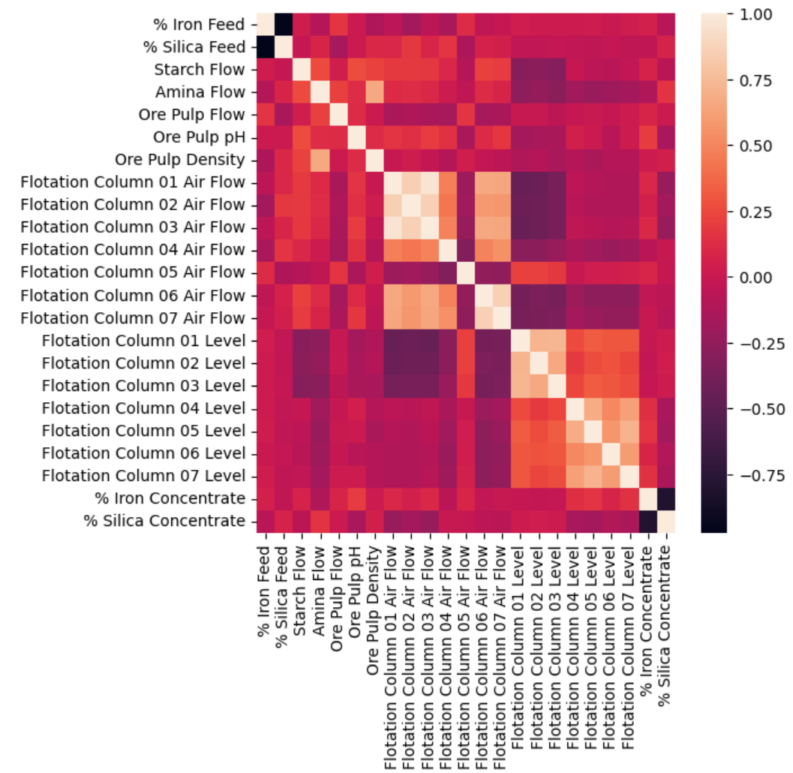
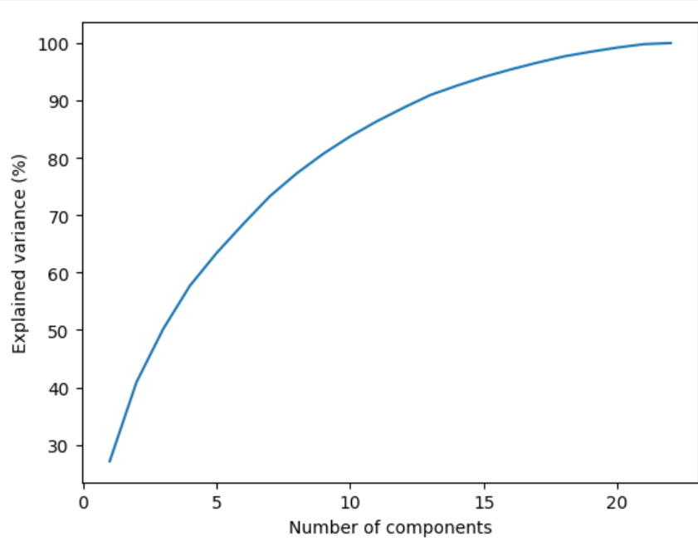
Results
fig.2.Scree plot
fig.1.Correlation matrix

Slide 10
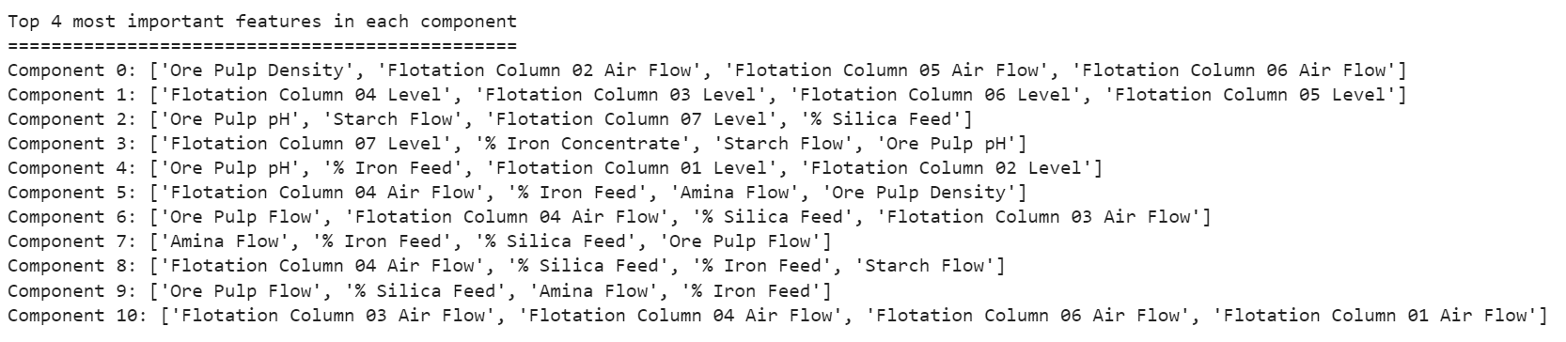
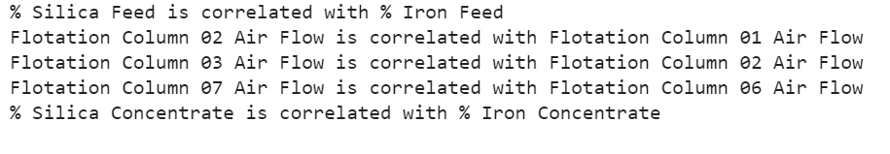
Results
fig.3.Top 4 most important features in each principal component
fig.3.Correlation analysis report

Slide 11
Regression performance summary
 | R2 | RMSE | MSE | MAE
Gradient boosting regressor | 0.91 | 1.9 | 3.9 | 1.5
Random Forest regressor | 0.98 | 0.8 | 0.7 | 0.43
Decision Tree regressor | 0.94 | 1.5 | 2.4 | 0.5
table.2.Summary of model performances

Slide 12

References
[1].W. D. Herlambang, K. A. Laksitowening and I. Asror, "Prediction of Graduation with Naïve Bayes Algorithm and Principal Component Analysis (PCA) on Time Series Data," 2021 9th International Conference on Information and Communication Technology (ICoICT), Yogyakarta, Indonesia, 2021, pp. 645-649, doi: 10.1109/ICoICT52021.2021.9527443.
[2].A. A. Supianto, T. Y. Christyawan, M. Hafis, Y. Hayashi, T. Hirashima and N. Hasanah, "Feature Dimensionality Reduction for Visualization and Clustering on Learning Process Data," 2019 International Conference on Sustainable Information Engineering and Technology (SIET), Lombok, Indonesia, 2019, pp. 84-89, doi: 10.1109/SIET48054.2019.8986020.
[3].A. Dogan, D. Birant and A. Kut, "Multi-Target Regression for Quality Prediction in a Mining Process," 2019 4th International Conference on Computer Science and Engineering (UBMK), Samsun, Turkey, 2019, pp. 639-644, doi: 10.1109/UBMK.2019.8907120.
[4].Y. I. Eremenko, D. A. Poleshchenko and Y. A. Tsygankov, "Prediction of Quality Indicators of Iron Ore Processing Operations Using Deep Neural Networks," 2020 2nd International Conference on Control Systems, Mathematical Modeling, Automation and Energy Efficiency (SUMMA), Lipetsk, Russia, 2020, pp. 425-429, doi: 10.1109/SUMMA50634.2020.9280676.

